Slide 1
Heritage Woods Secondary
Monday
December 12, 2022
“WE ARE KODIAKS”

Slide 2
Bell Schedule
Block 1 | 8:00 – 9:12
Block 2 | 9:16 – 10:28
FLEX | 10:28 – 10:59
Block 3 | 11:03 – 12:15
LUNCH | 12:15 – 12:55
Block 4 | 12:59 – 2:11
Block 5 | 2:15 – 3:27

Slide 4
Bell Schedule
*No FLEX first Monday of every Month: 3PM Dismissal
Block 1 | 8:00 – 9:12
Block 2 | 9:16 – 10:28
Block 3 | 10:32 – 11:44
LUNCH | 11:44 – 12:28
Block 4 | 12:32 – 1:44
Block 5 | 1:48 – 3:00

Slide 5
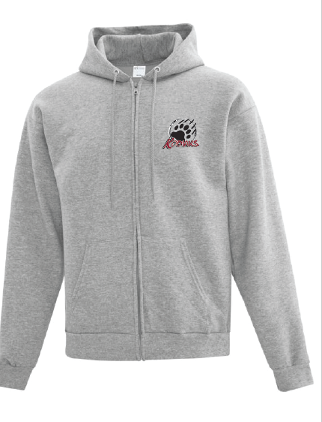
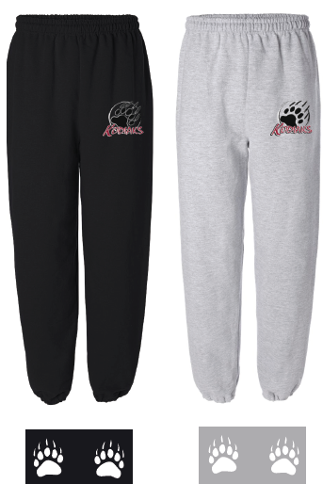
KODIAK CLOTHING
HAS ARRIVED!
Pick up at the
MAIN OFFICE

Slide 7
The Literacy and Numeracy 10 Assessments for Graduation
All students are required to write the Literacy and Numeracy 10 Assessments for graduation.
Students who currently enrolled in and of our English 10 or Math 10 classes for Semester 1 will be writing the corresponding assessment in January.
Students who are enrolled in a Math or English class in second semester will write in June.
Students who have already completed their Math or English 10 will also write in June UNLESS they have already asked to write in January. They are asked to email Ms Payne jpayne@sd43.bc.ca to register for the June session.
All grade 10's are asked to check the lists posted outside the library on Thursday and Friday to check if they are on the list for the January assessment period. If you believe you should be writing you MUST email Ms Payne on Friday.
January 23 - Literacy 10
January 25 - Numeracy 10
If you have any questiosn regarding the assessments, please contact Ms Payne.

Slide 9
Fragrance Free
Reminder to all that SD43 is Scent Aware, and as such the district is asking for cooperation towards a scent reduced environment.
All staff, students and visitors are strongly encouraged to avoid or reduce the use of fragranced products, and to replace them with unscented alternatives.

Slide 10
KODIAK Good Deeds
The following students are asked to please come to the main office:

Slide 11
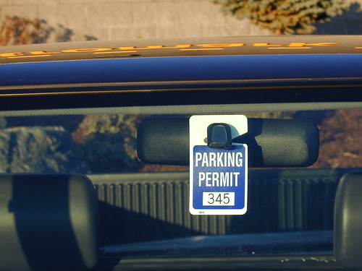
STUDENT PARKING PASSES
Reminder to students who are driving to school and parking in the school parking lots.
Please come to the HWSS main office to register your vehicle and receive a PARKING PASS to be displayed in vehicle. Usually hang from rear view mirror.

Slide 12
STUDENT PARKING PASSES
If you completed the registration form your Parking Pass is ready for p/u from the main office.
Usually hang from rear view mirror.

Slide 13
Could the following students please come to the office to see Ms. Hall
Kai H. - Student Card
Andrea A. - Student Card
Matthew B. - Student Card
Eshan N. - Transcript
Shourya S. - Transcript

Slide 14
FREE
Coquitlam Express Tickets
Tickets available at the office. First come, first served.
Coquitlam Express VS Alberni Valley Game
Poirier Sports and Leisure Centre
Wednesday, December 14, 2022
7:00pm

Slide 15
CLC12 MEETING TIMES
Hey grade 12’s! Please attend your scheduled FLEX time according to the sectioned schedule below.
TBC | Ms. Fester | Rm 102
TBC | Ms. Gay | Rm 103
TBC | Ms. Lee | Rm 244
TBC | Ms. Saloustros | Rm Theatre
TBC | Ms. Nunn | Rm 109
TBC | Ms. Nunn | Rm 109
TBC | Ms. Jarvis | Rm Theatre
TBC | Mr. Baldus | Rm 311
TBC | Ms. Wood | Rm 202
TBC | Mr. Santarossa | Rm 203
TBC | Ms. Swanson | Library Computer Lab

Slide 16
HWSS LIBRARY
– Please come to the Library. The book you requested is now available for p/u.

Slide 17
CLUBS

Slide 19
KWAP Food Drive
Date it ends: Dec 14th
Location: Drop-off sign in front of Ms. Nunn’s office
What: Non-perishable food items
Ex. Canned food, pasta or rice
Anyone is welcome to donate!
KWAP members can get volunteer hours!
Donations are going to the SHARE Food Bank.

Slide 20
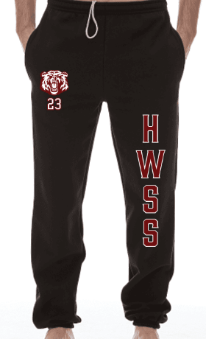
GRAD WEAR STORE is Open!!!
https://store.passionsports.ca/HWSS23
STORE CLOSES DECEMBER 16th

Slide 21
Club Names & Sponsor Teachers If you are interested in joining a club pls contact the sponsor teacher!
Art Club – Mr. Ting
Barz Club – Mr. Zenone
Book Club – Ms. Ferrer
Business Club – Mr. Sather
Chess Club – Mr. Sun
Creative Minds Club – Ms. Ross
Curling Club – Ms. Wood
Debate Club – Mr. Zenone
Dungeons and Dragons Club – Mr. Blake/Ms. Nezil
Economics Club – Ms. Gilder
Enviro Club – Mr. Modder
First Responders – Mr. Baldus
History Club - Mr. Chaffee
Host Club – Mr. Chan
JA Business Club – Mr. Sather
Kodiak Pride – Ms. Leeden
KWAP Club – Ms. Nunn
Law Club – Mr. Aitken
Math Club - Ms. Weinkam
Multicultural Club – Ms. Lee
MUN – Mr. Chaffee
Pediatric Health Alliance - Mr. Gleckman
Photo Club - Ms. Vickerson
Physics – Mr. Khalili
Quilting Club – Ms. Woods
Robotics – Mr. Au-Lange

Slide 22
KODIAK
ATHLETICS

Slide 23
CAREER CENTER

